Slide 1
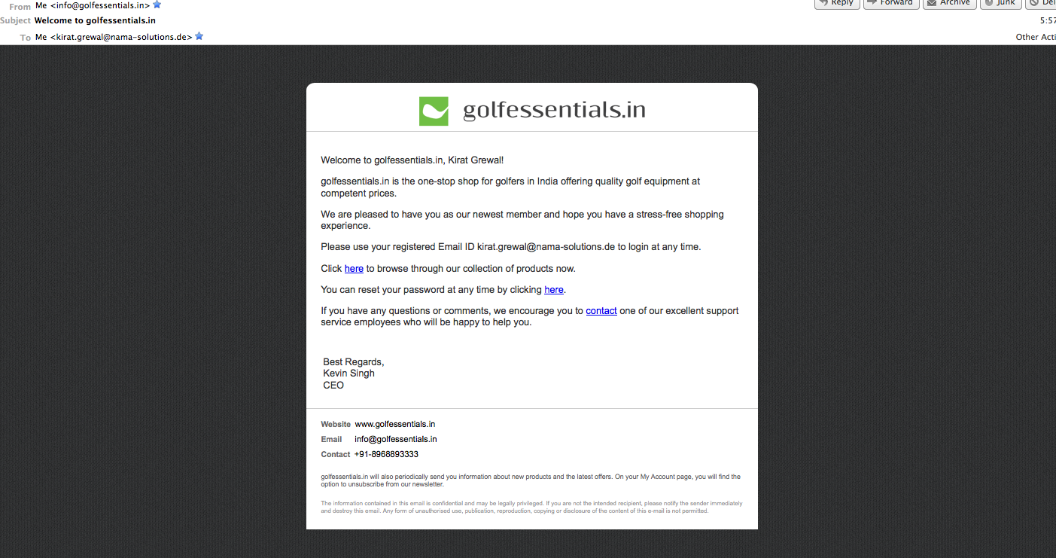
On registering: From: info@golfessentials.in Subject: Welcome to golfessentials.in
ok

Slide 2
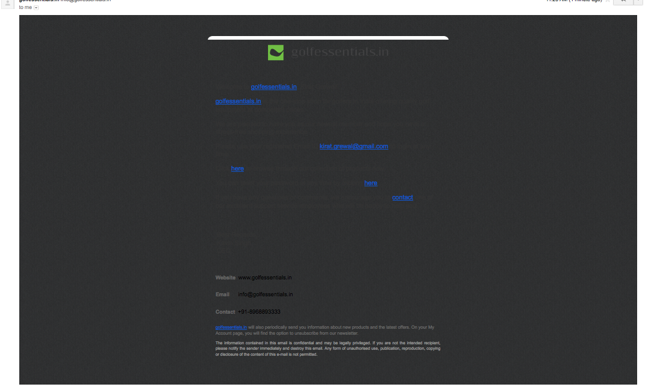
Email received on gmail today (Wednesday, 7 Nov 12). Can we add a link to view the content on the browser? What are the other alternatives?

Slide 3
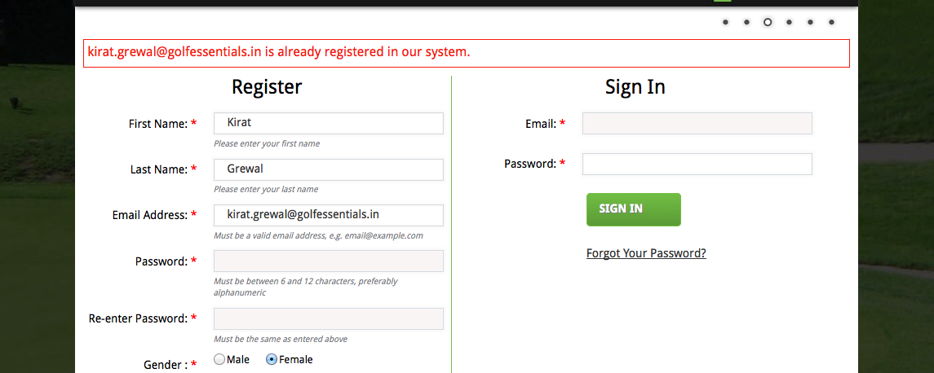
Add
Forgot your password? We’ll email it to you
DONE

Slide 4
On the website – on registering
Re-direction to landing page
ok

Slide 5
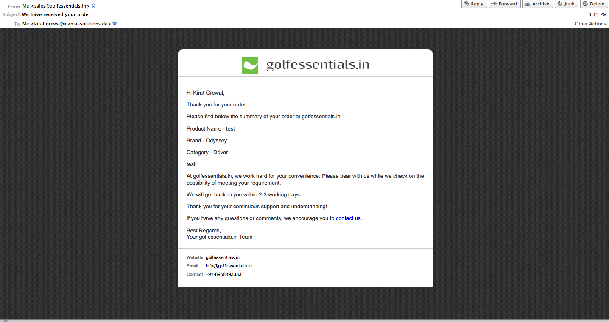
On receiving a Special Order: From: sales@golfessentials.in Subject: We have received your order
ok

Slide 6
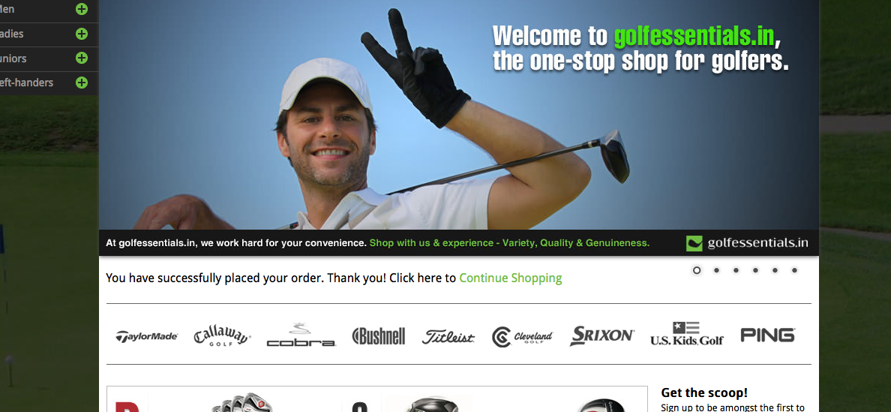
‘here’ should be hyperlinked, and not ‘Continue Shopping’ DONE

Slide 7
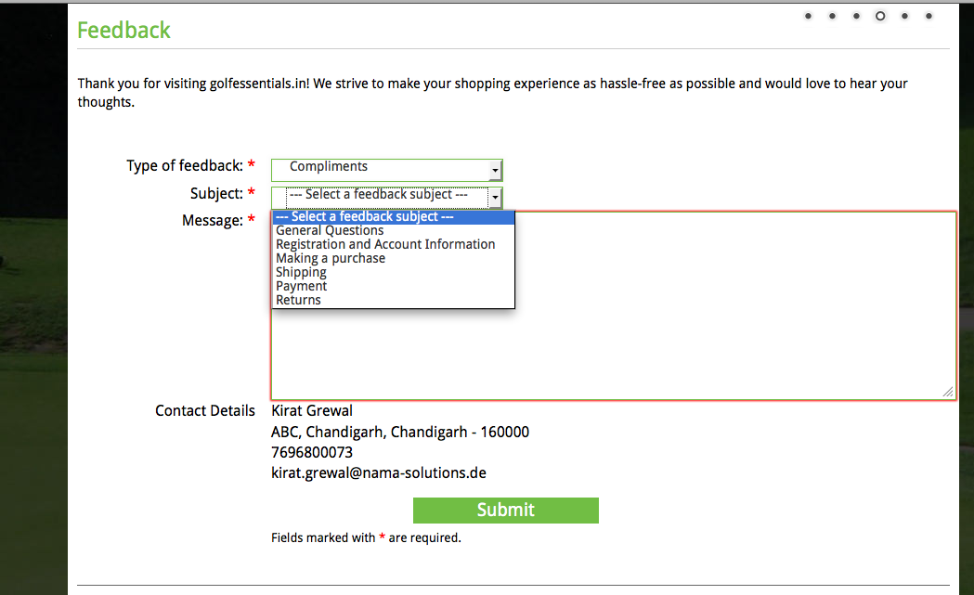
Availability of products (3)
Support Service (5)
DONE

Slide 8
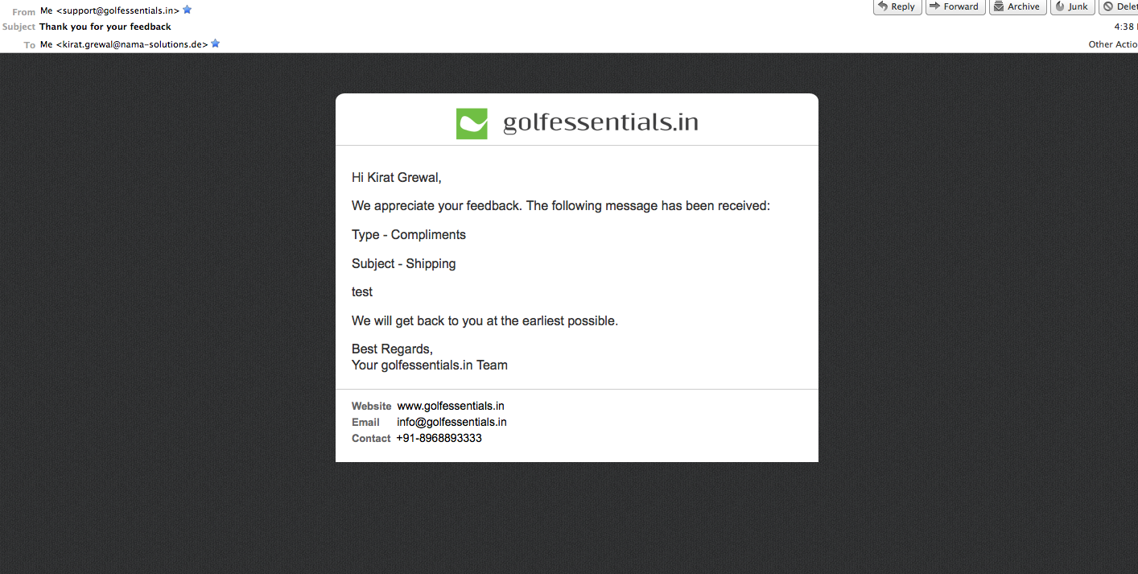
On receiving feedback: From: support@golfessentials.in Subject: Thank you for your feedback
ok

Slide 9
On the website
Your feedback has been received. Thank you! Click here to continue shopping.
DONE

Slide 10
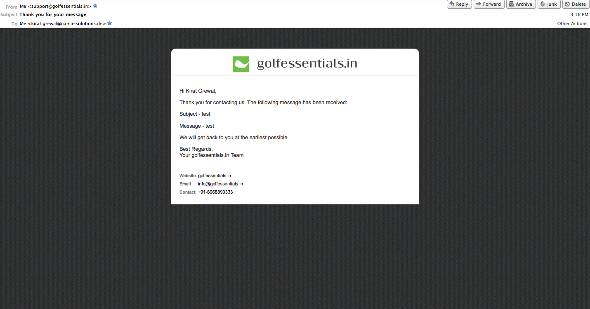
On receiving a message through contact us: From: support@golfessentials.in Subject: Thank you for your message
ok

Slide 11
On the website
Your message has been received. Thank you! Click here to continue shopping.
DONE

Slide 12
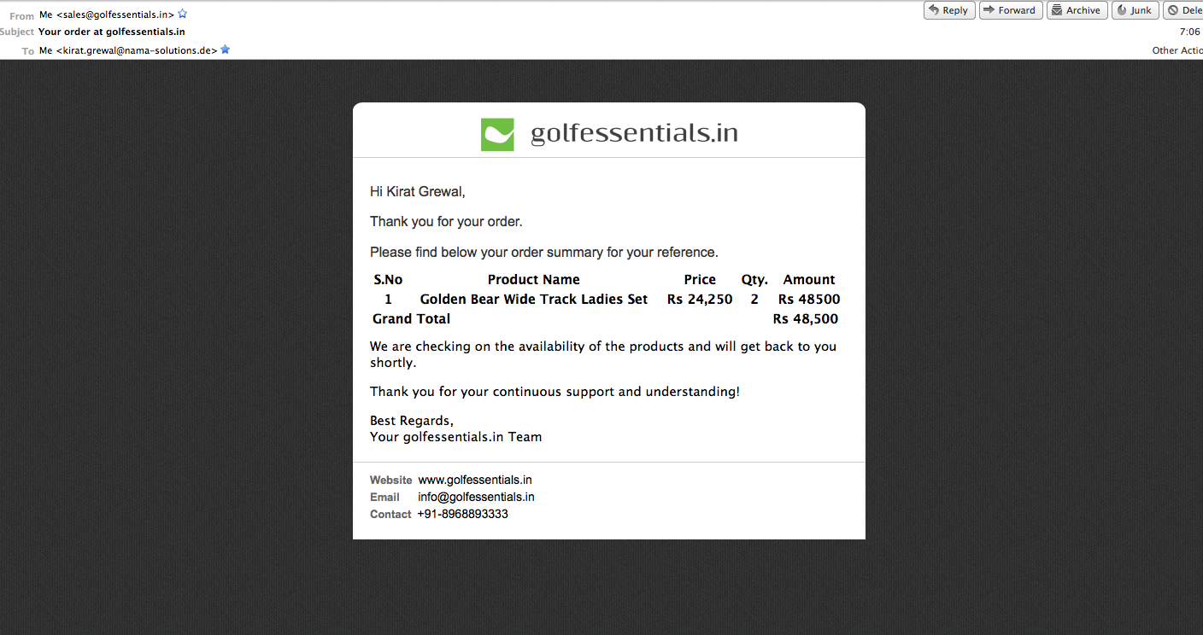
On receiving an order: From: sales@golfessentials.in Subject: Your order at golfessentials.in
ok

Slide 13
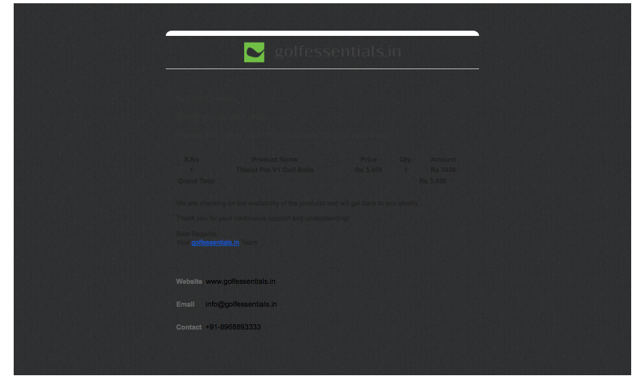
Email received on gmail today (Wednesday, 7 Nov 12).

Slide 14
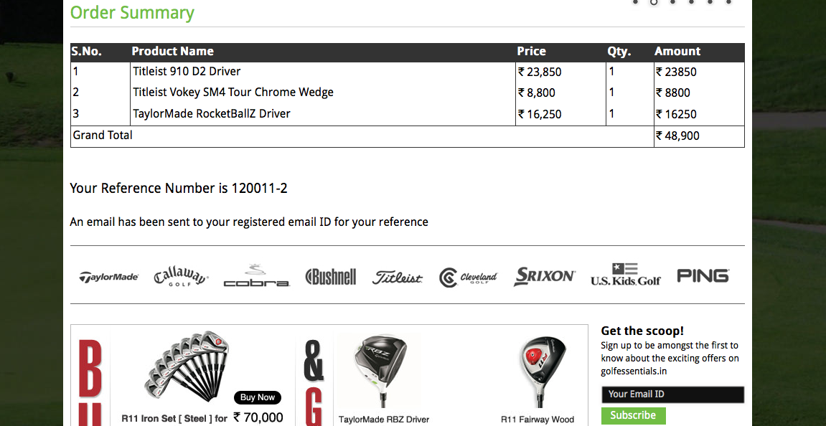
On the website
ok

Slide 15
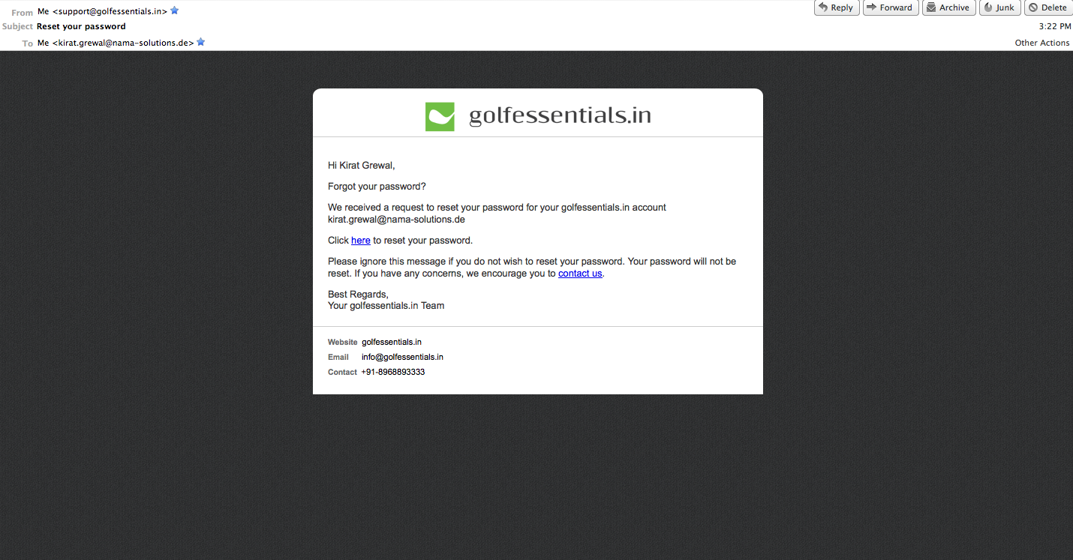
Forgot password: From: support@golfessentials.in Subject: Reset your password
ok

Slide 16
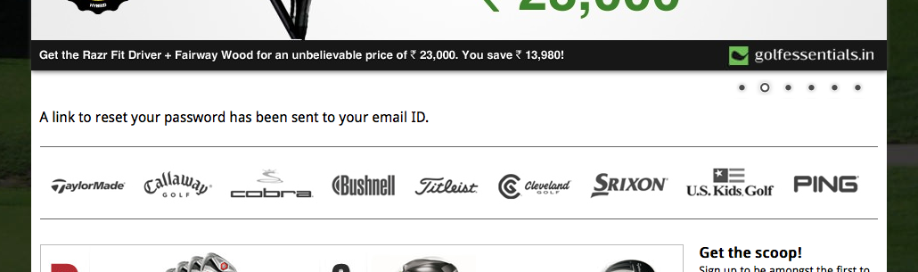
Add
Please feel free to contact us for any further assistance.
DONE

Slide 17
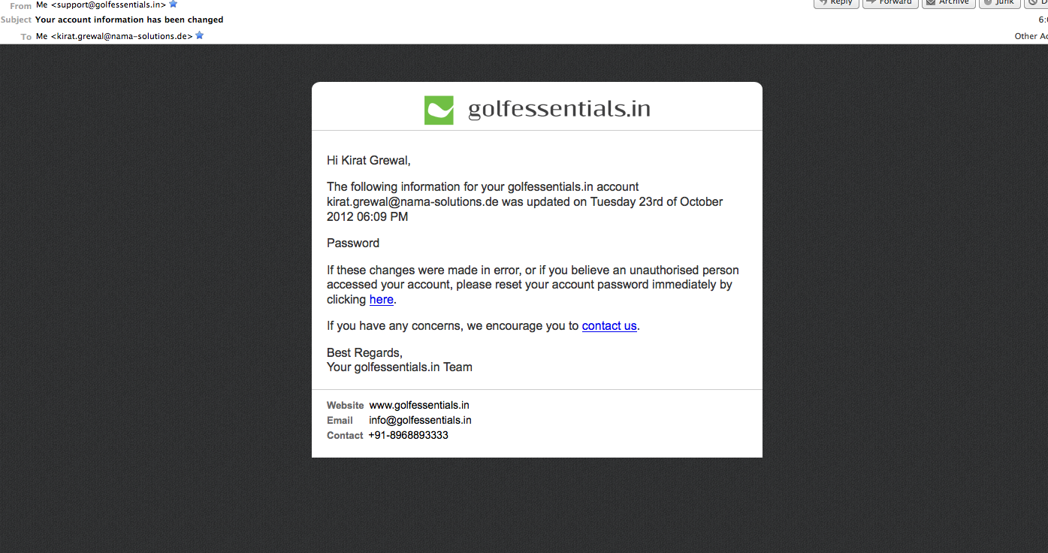
Change of account information: From: support@golfessentials.in Subject: Your account information has been changed
ok

Slide 18
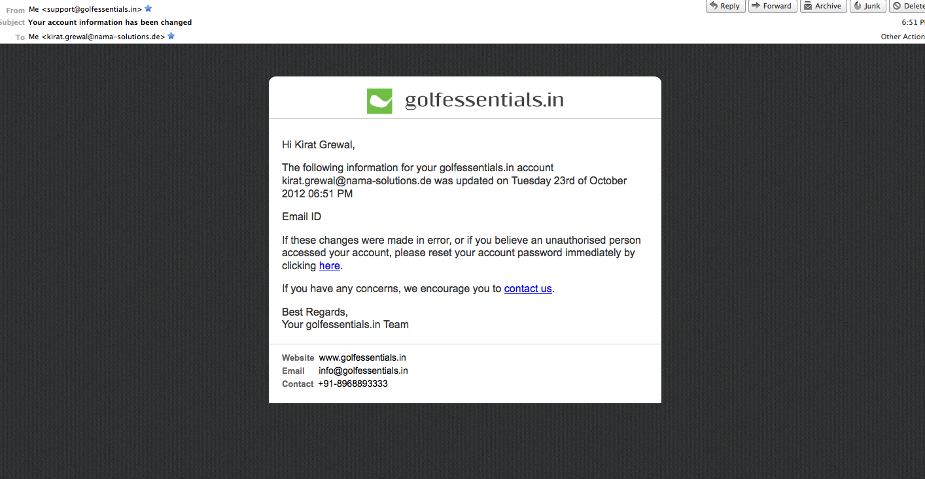
Change of account information: From: support@golfessentials.in Subject: Your account information has been changed
ok

Slide 19
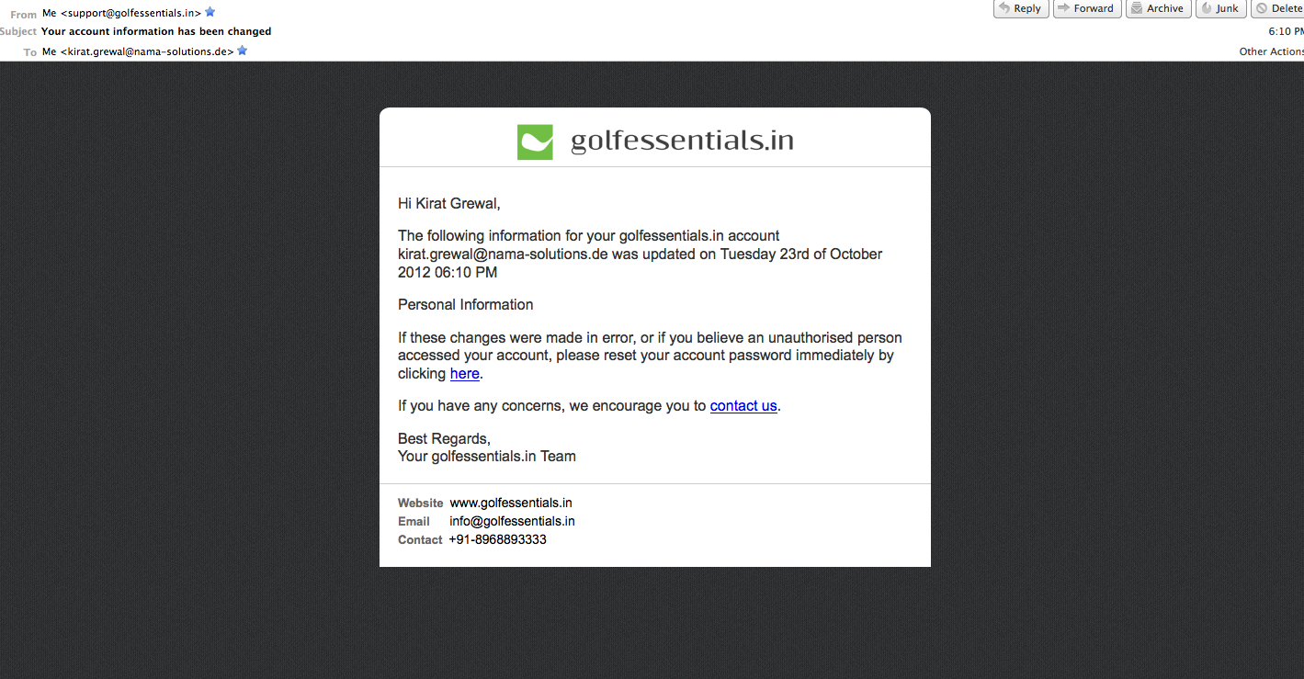
Change of account information: From: support@golfessentials.in Subject: Your account information has been changed
ok

Slide 20
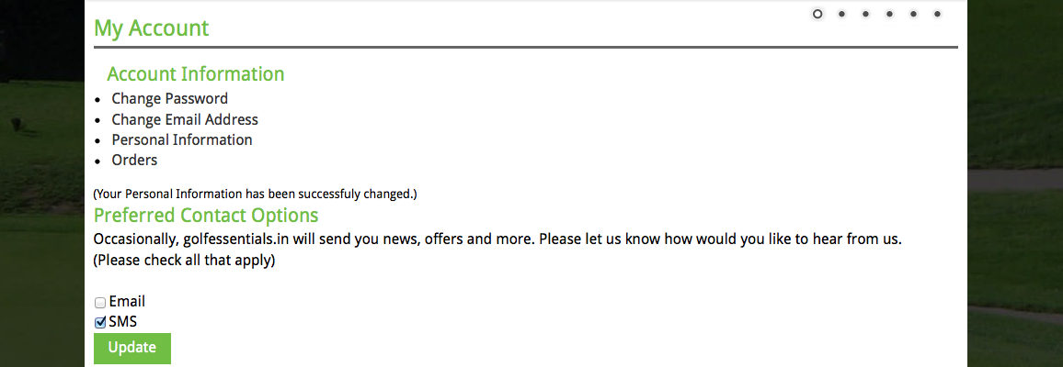
On the website
Should appear in bold
DONE

Slide 21
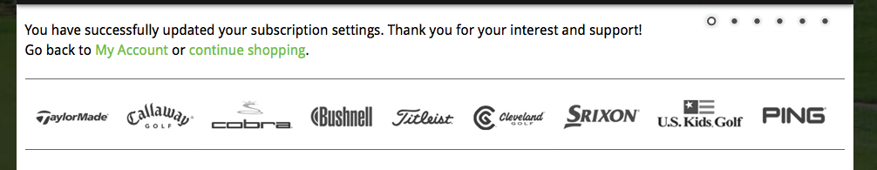
On the website – on updating preferred contact options
preferred contact options
Continue Shopping
Should be the same message for all combinations (whether one, both or none are checked)
DONE

Slide 22
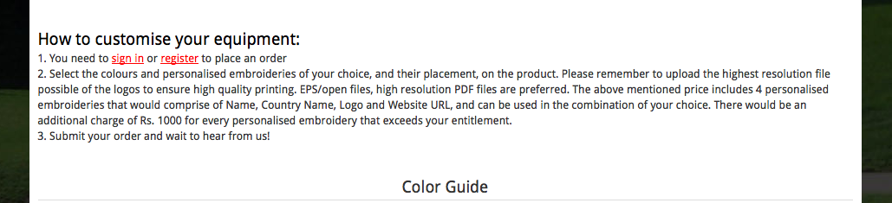
Step (Step 1, Step 2, Step 3)
To be checked for each product
optimum quality output
DONE

Slide 23
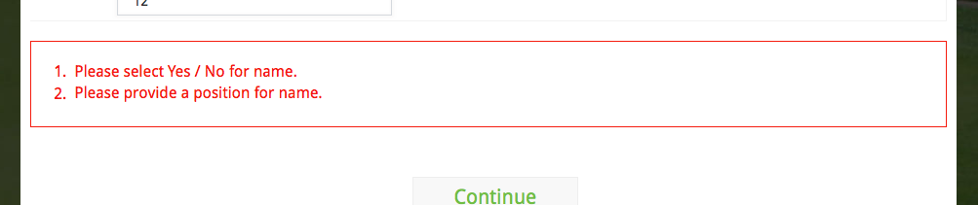
check Yes or No, as applicable for the presence of the name on the bag
the name on the bag

Slide 24
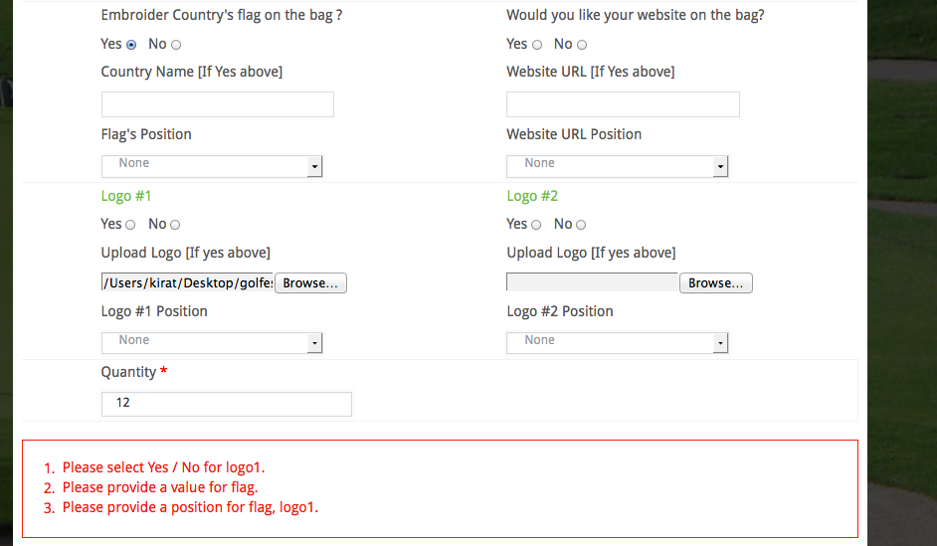
check Yes or No, as applicable for the presence of Logo #1 on the bag
enter the country name
the Flag & Logo #1 on the bag

Slide 25
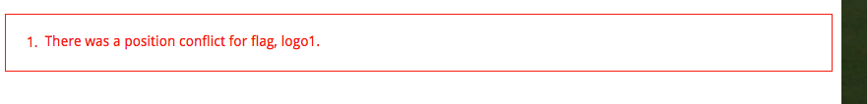
for the placement of the Flag & Logo #1 on the bag

Slide 26
Error Messages and notes
On selecting more than the possible number of embroideries:
Sorry, you can only select __ customised embroideries on this product DONE
On entering a quantity less than the minimum order:
Sorry, the minimum order is ___ DONE
Note to be added where Price on request is mentioned:
(The price depends on the quantity and the complexity of the embroideries. You will be informed of the price shortly after you place your order. You will then have the option to confirm or cancel your order.) DONE

Slide 27
Error Messages in case Yes or no is not selected
Please check Yes or No, as applicable for the presence of
the name
the country flag
the website URL
Logo #1/#2…
on the bag

Slide 28
Error Messages in case Yes is selected and no other information is entered
Please enter
the name
the country name
the website URL
Please upload
Logo #1/#2…
Please provide a position for
the name
the country flag
the website URL
Logo #1/#2…
on the bag

Slide 29
In case of a position conflict (this should not appear if the user has exceeded the max no. of embroideries)
There was a position conflict for the placement of
the name &/
the country flag &/
the website URL&/
Logo #1/
Logo #2/….
on the bag

Slide 30
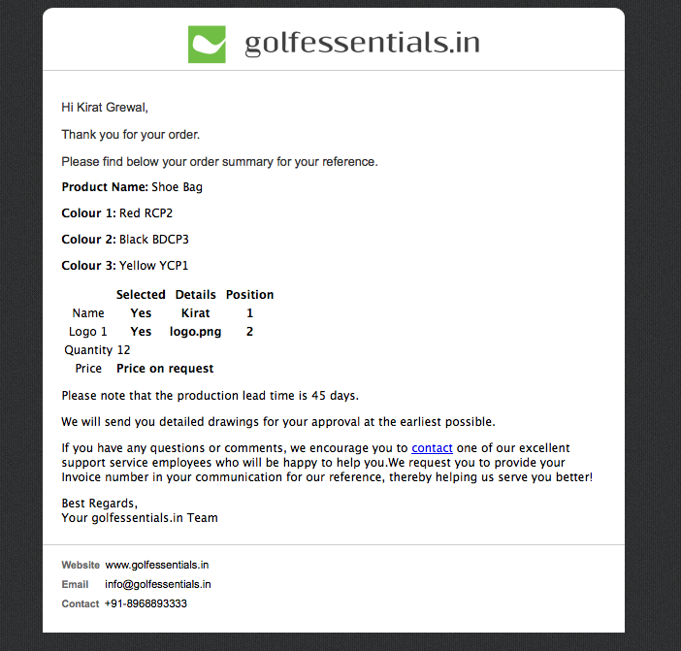
In case of price on request, please add the copy that I’ve put in green
This should be in bold as well
(We will get back to you shortly on this)
from the day you confirm your order.
after we receive your confirmation on tshortly he price
add space
DONE

Slide 31
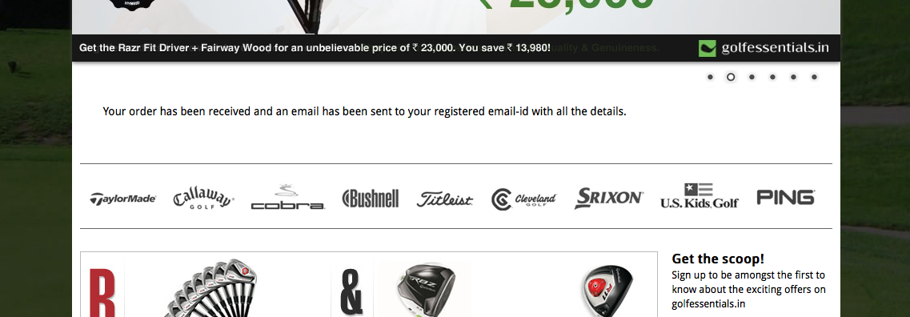
successfully placed
email ID with the order summary
DONE

Slide 32
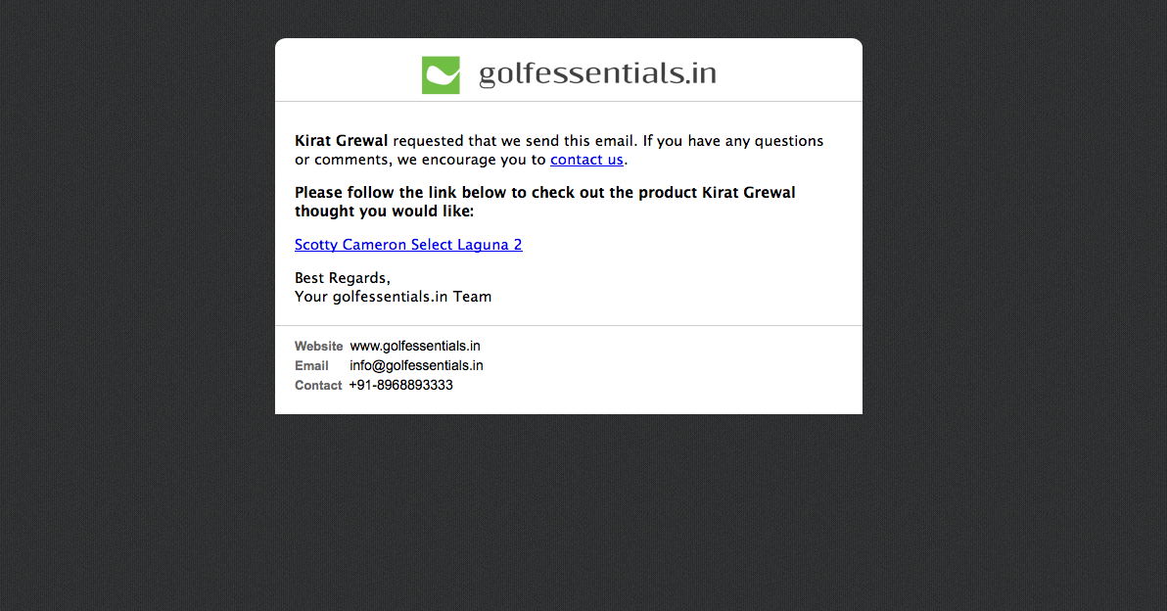
Share by email
From: info@golfessentials.in Subject: __ wants you to see this item at golfessentials.in
ok

Slide 33
Emails yet to be worked on/pending review
Confirmation of availability
On dispatching products
Products have been in your wishlist for over 2 months
Unsubscribe
Promotional mail

